Slide 1
SALES DATA ANALYSIS
BY ; ANURIYA RAVEENDRAN
BATCH : DA-DS
REINFORCEMENT 6 : POWER-BI DATA VISUALIZATION

Slide 2
INTRODUCTION
🔹 Leveraged Power BI for data cleaning, transformation, and visualization to extract meaningful insights.
🔹 Applied DAX functions to calculate key metrics and enhance analytical capabilities
🔹 Created interactive dashboards to visualize trends, KPIs, and business performance effectively.

Slide 3
AIM
🔹 To analyze, transform, and visualize data using Power BI for meaningful insights.
🔹 To apply DAX functions for calculating key metrics and enhancing decision-making.
🔹 To design dynamic dashboards for interactive data exploration and reporting.

Slide 4
DATASET OVERVIEW
TransactionNo | Date | ProductNo | ProductName | Price | Quantity | CustomerNo | Country
581482 | 12-09-2019 | 22485 | Set Of 2 Wooden Market Crates | 21.47 | 12 | 17490 | United Kingdom
581475 | 12-09-2019 | 22596 | Christmas Star Wish List Chalkboard | 10.65 | 36 | 13069 | United Kingdom
581476 | 12-09-2019 | 23198 | Pantry Magnetic Shopping List | 11.53 | 48 | 12433 | Norway
581477 | 12-09-2019 | 48111 | Doormat 3 Smiley Cats | 17.51 | 10 | 13426 | United Kingdom
581478 | 12-09-2019 | 84947 | Antique Silver Tea Glass Engraved | 11.53 | 24 | 17364 | United Kingdom
581479 | 12-09-2019 | 22087 | Paper Bunting White Lace | 13.27 | 10 | 17364 | United Kingdom
581480 | 12-09-2019 | 23464 | Vintage Zinc Watering Can Small | 15.32 | 4 | 14441 | United Kingdom
581481 | 12-09-2019 | 21115 | Rose Caravan Doorstop | 12.25 | 8 | 17490 | United Kingdom
581483 | 12-09-2019 | 23843 | Paper Craft Little Birdie | 12.38 | 80995 | 16446 | United Kingdom

Slide 5
DATA UNDERSTANDING
The dataset contains transactional data, including product details, pricing, customer information, and sales performance.
🔹 Key Columns:
TransactionNo → Unique identifier for each transaction
Date → Date of the transaction
ProductNo → Unique product identifier
ProductName → Name of the product sold
Price → Price per unit of the product
Quantity → Number of units sold
CustomerNo → Unique customer identifier
Country → Location where the transaction took place

Slide 6
Power query editing : data cleaning
Before analyzing sales data in Power BI, it's crucial to clean and prepare the dataset to ensure accuracy and reliability. Data cleaning helps remove errors, inconsistencies, and missing values that could affect insights.
Step 1: Import Data into Power BI
Step 2: Handle Missing & Null Values
Step 3: Remove Duplicates
Step 4: Correct Data Types

Slide 7
Dax functions
DAX (Data Analysis Expressions) is a powerful formula language used in Power BI, Power Pivot, and Analysis Services to create custom calculations and aggregations. It helps in building measures, calculated columns, and calculated tables foradvanced data modeling and analysis.
sum_of_totalsales = SUM('Sales Transaction v 4a (2)'[total sales])
Average Price = AVERAGE('Sales Transaction v 4a (2)'[Price])
Avg Revenue per Transaction = AVERAGE('Sales Transaction v 4a (2)'[Total Sales])
Gross Margin % = DIVIDE(SUM('Sales Transaction v 4a (2)'[Price]),SUM('Sales Transaction v 4a (2)'[Total Sales]),0)
Unique Products Sold = DISTINCTCOUNT('Sales Transaction v 4a (2)'[ProductNo])

Slide 8
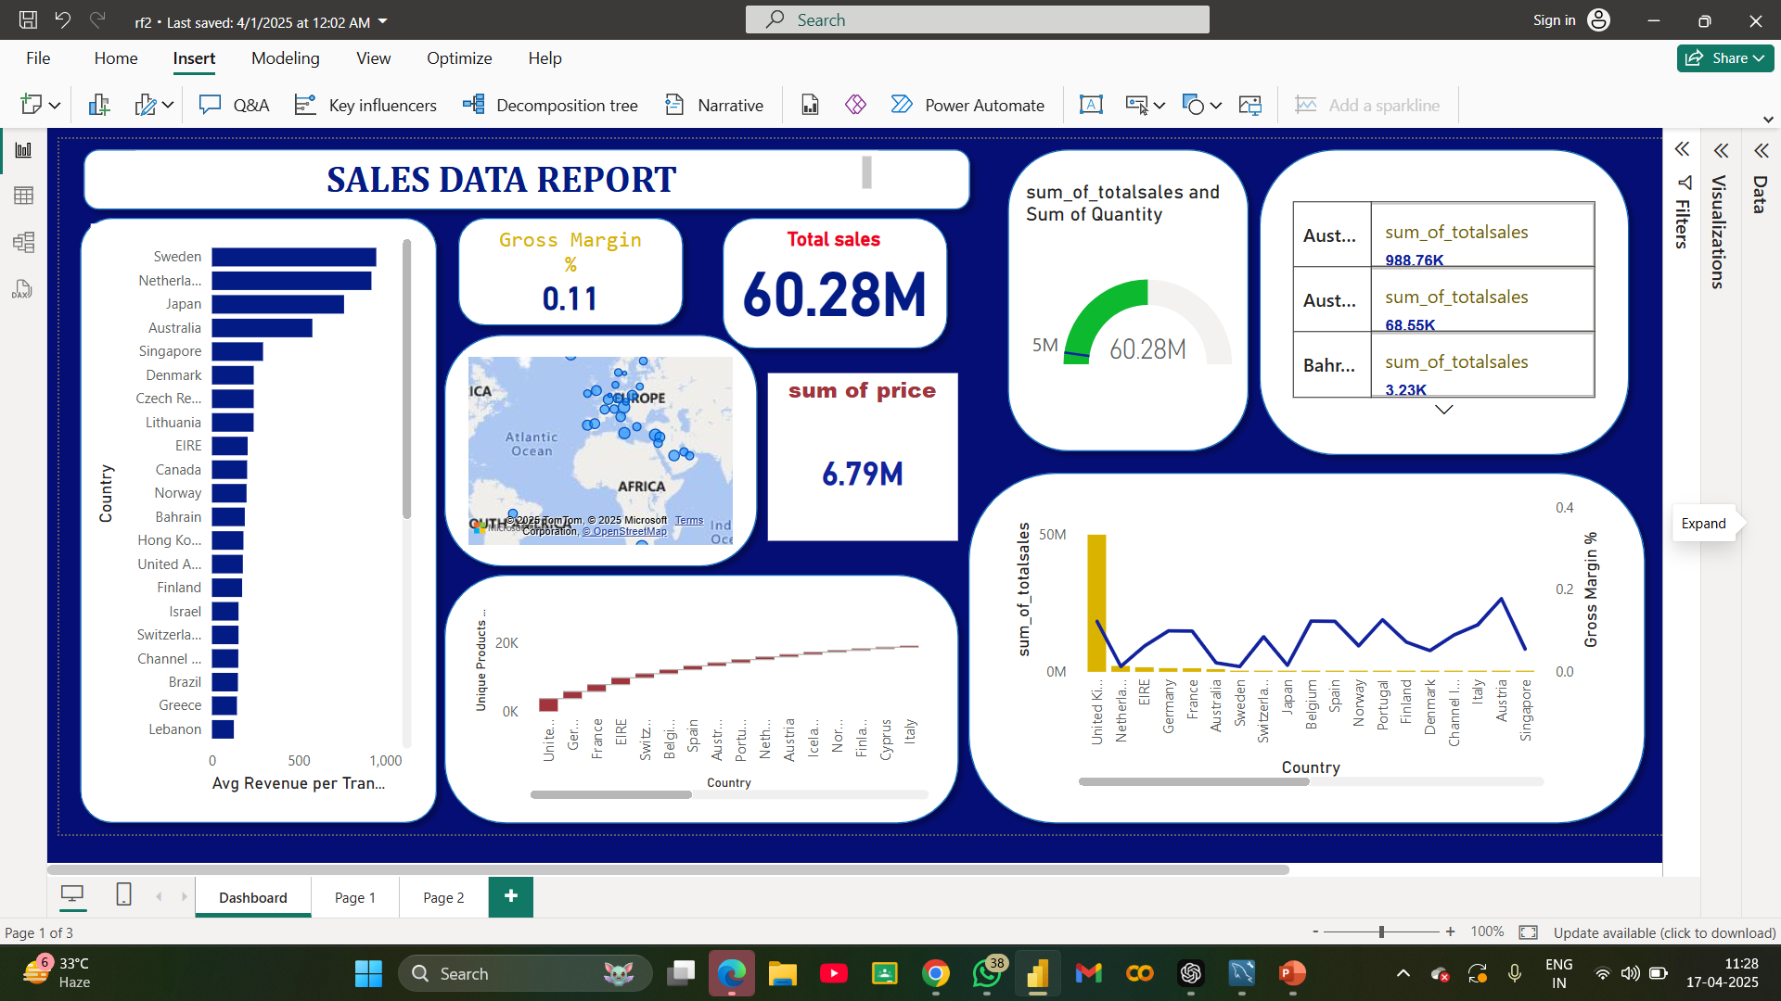
Dashboard overview

Slide 9
CONCLUSION
🔹 Sales Performance: The total sales amount is 60.28M, indicating a significant revenue stream across multiple regions.
🔹 Country-wise Insights:
United Kingdom, Netherlands, and Germany contribute the highest unique product sales and revenue.
Sweden and Japan have the highest average revenue per transaction, suggesting premium product purchases.
🔹 Profitability:
Gross Margin % is 0.11, which indicates room for profitability improvement.
Some countries show high sales but lower margins, suggesting a need for better cost optimization strategies.
🔹 Visualization Impact:
The bar chart, line graph, and map provide a clear geographical sales distribution.
KPI cards effectively highlight key metrics like total sales and gross margin for quick insights.

Slide 10
THANKYOU !

